Slide 1
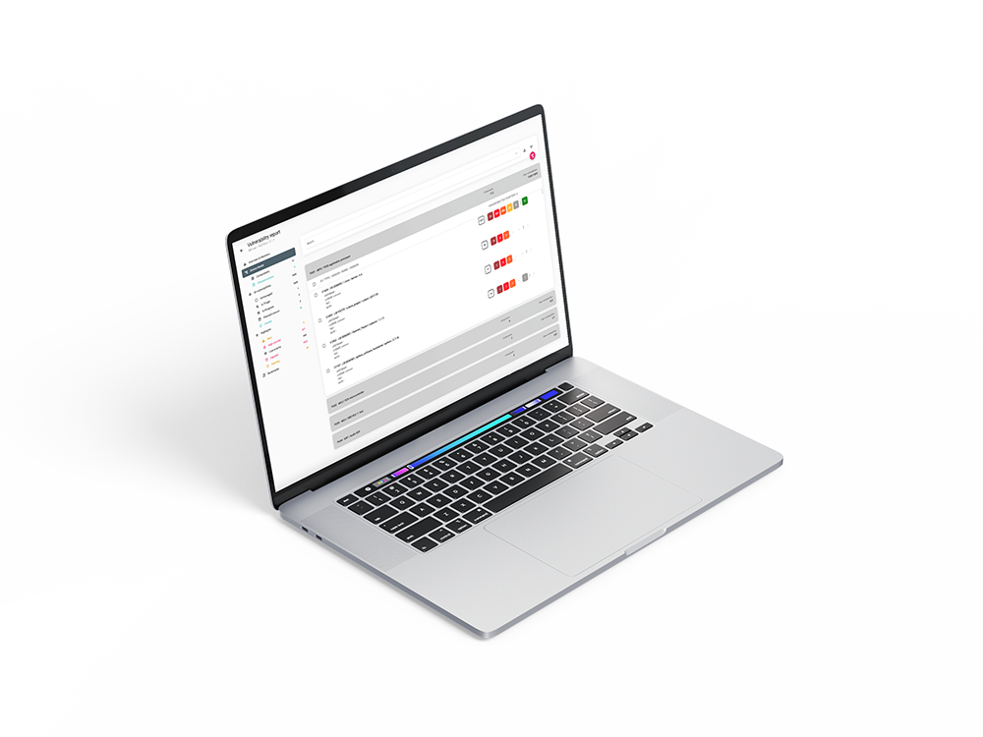

Get grip on product security with ARIANNA
HBOM & SBOM creation | Vulnerability monitoring | Vulnerability management
ARIANNA is a product by
Notes:
Today I want to show how ARIANNA helps manufacturers operationalize product security. The focus is on HBOM and SBOM creation, continuous monitoring, and vulnerability management in one workflow.

Slide 2
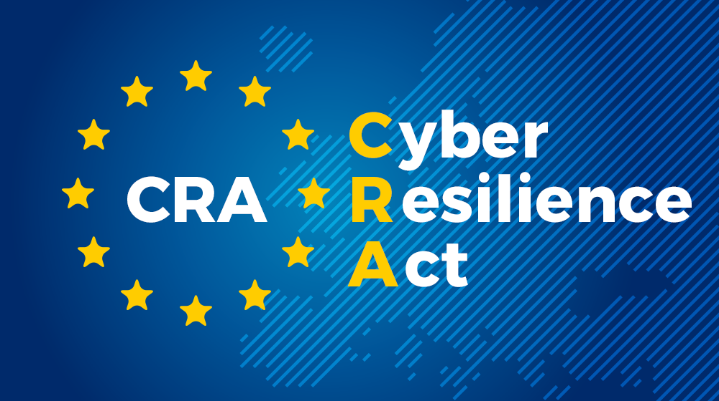
Why Manufacturers Struggle with CRA
CRA requires continuous vulnerability management across the full product lifecycle.
Manufacturers must maintain SBOMs, monitor vulnerabilities, assess risk, and address findings.
Many organizations have some of the building blocks, but not an operational process that scales.
Notes:
The challenge is not only understanding CRA requirements, but making them work in daily operations. Many companies have parts of the puzzle, but not a scalable end-to-end process.

Slide 3
Why ARIANNA exists
Connected products combine hardware and software and often remain in the field for years.
Manual vulnerability tracking does not scale in that environment.
ARIANNA brings HBOM + SBOM visibility, monitoring, prioritization, and reporting into one platform.
Notes:
Connected products are different from classic IT systems. They combine hardware and software, stay in the field for years, and create a vulnerability management challenge that manual processes simply cannot handle.

Slide 4
From 2,775 Vulnerabilities to 10 Actions
A connected device can contain thousands of known vulnerabilities.
CVSS-only prioritization can leave teams with hundreds of issues to review.
ARIANNA prioritizes based on exploitability and device context, reducing the focus to the vulnerabilities that matter most.
CVSS measures severity. ARIANNA prioritizes risk.
Notes:
This is the core problem we solve. A device can contain thousands of known vulnerabilities, but teams do not need thousands of actions. They need a short, relevant list of what actually matters.

Slide 5
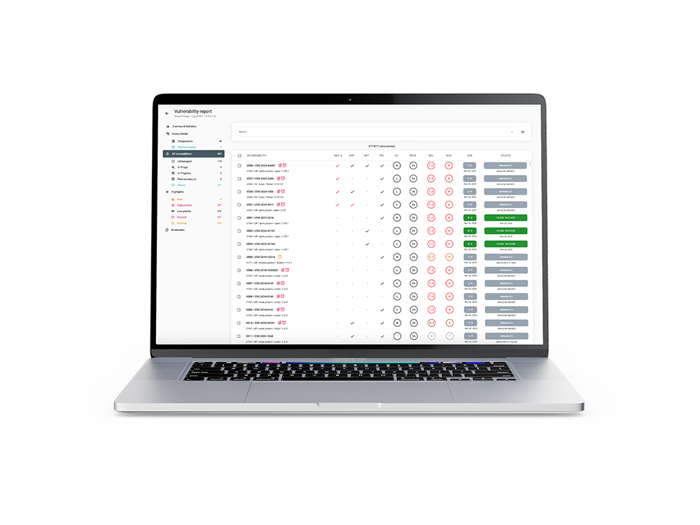
How ARIANNA operationalizes product security
ARIANNA helps device manufacturers run an efficient vulnerability management process.
Build and maintain the device model (HBOM + SBOM)
Continuously monitor new vulnerabilities
Prioritize based on real exploitability and device context
Export reports for customers, internal teams, and regulators
Notes:
ARIANNA is designed to make vulnerability management operational. It starts from the device model, continuously monitors new vulnerabilities, prioritizes based on real risk, and supports reporting to all relevant stakeholders.

Slide 6
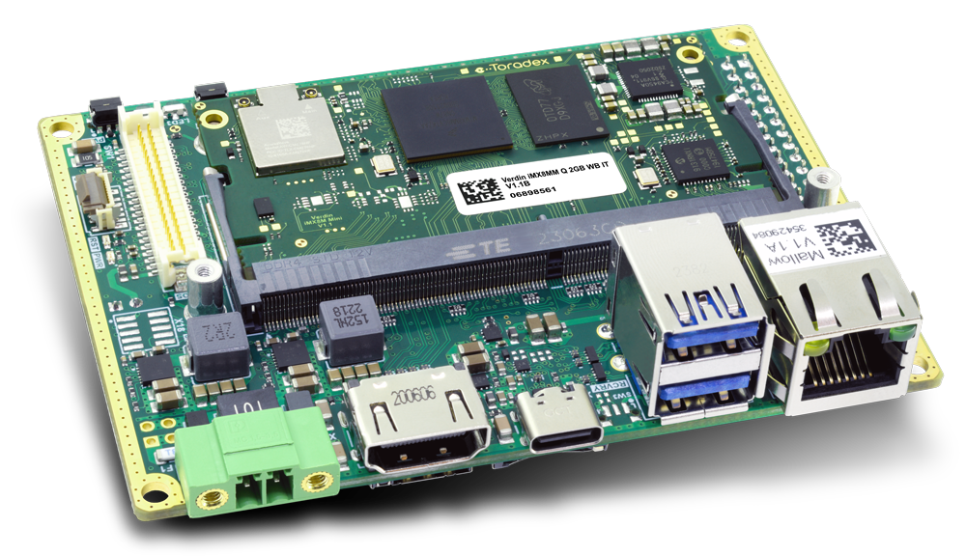
Smart devices are not just software
Hardware Components
MCUs | MPUs | Memories
WiFi, BLE, radio modules | Secure Elements | TPM
Vulnerability management for devices is incomplete without the hardware model.
Hardware components manage critical assets.
Hardware components have vulnerabilities.
They are not exposed to attackers in the same way as software.
The hardware model helps exclude non-reachable software vulnerabilities.
WIFI MODULE
MAIN MPU
MEMORY
MCU
Notes:
In smart connected products, hardware matters just as much as software. If you do not model the hardware context, you miss critical assets, exposure assumptions, and important filtering logic.

Slide 7
Device Model creation: HBOM
The user identifies the main hardware building blocks of the device.
Each hardware building block is modeled as a Processing Unit (PU).
Examples include MCUs, MPUs, Secure Elements, memories, and WiFi/BLE modules.
For each PU, ARIANNA derives the HBOM from the validated hardware part number.
PU3|ESP32
PU1 | i.MX 93
PU4 | MEMORY
PU2 | STM32F4
Notes:
The first step is to model the hardware building blocks of the device. In ARIANNA, each of these is represented as a processing unit, and that creates the HBOM foundation.

Slide 8
Device Model creation: SBOM
For each Processing Unit (PU), ARIANNA supports the creation of the SBOM.
A PU SBOM can combine multiple SBOMs from different software layers.
For MPUs this can include the OS plus customer applications.
For MCUs this can include the bootloader plus application firmware.
The final device SBOM preserves that structure for clearer vulnerability analysis.
Javascript Application
SBOM
Python Application
SBOM
YOCTO SBOM
Bootloader SBOM
Firmware SBOM
Firmware SBOM
PU1 | i.MX 93
PU2 | STM32F4
PU3 | ESP32
Notes:
For each processing unit, ARIANNA supports the creation of the relevant SBOMs. This is important because embedded devices usually contain multiple software layers that need to be analyzed separately but understood together.

Slide 9
Device Model lifecycle & VMP
The device model evolves over the product lifecycle.
HBOM usually remains stable, while SBOM changes with new software and firmware releases.
Each new model version can introduce new vulnerabilities and automatically close others when affected components are updated or removed.
Notes:
The device model is not static. HBOM is usually stable, but SBOM evolves with each release, and that directly affects which vulnerabilities are identified, remain open, or can be closed.

Slide 10
Continuous Vulnerability Monitoring
ARIANNA identifies new vulnerabilities daily for every monitored device based on its device model.
It uses an internal mapping between hardware/software components and known vulnerabilities.
Public sources such as NVD, CVE.org, GitHub Advisories, and EUVD are monitored continuously.
Findings are enriched with KEV status, EPSS, exploit maturity, and CWE information to support better prioritization.
Notes:
Once the device model exists, ARIANNA continuously monitors new vulnerabilities against it. The goal is not just detection, but detection enriched with the information needed for meaningful prioritization.

Slide 11
Severity alone is not enough
CVSS is useful, but severity alone is not enough for prioritization.
Context matters: a vulnerability in a non-exposed component is very different from the same vulnerability in an internet-facing device.
Exploitability matters more than volume.
This is why device-specific context is essential for effective vulnerability management.
Notes:
Traditional vulnerability management relies heavily on CVSS, but severity alone does not tell us what matters most for a specific device. Device context and exploitability are what make prioritization actionable.

Slide 12
Operational triage at scale
ARIANNA includes a configurable pre-triage engine to reduce review workload.
It creates a focused queue for the vulnerabilities that need immediate analyst attention.
Lower-priority items remain visible and traceable without consuming the same level of effort.
This helps teams scale triage while keeping final decisions in human hands.
Notes:
This is where ARIANNA reduces workload. Instead of forcing teams to review everything with the same intensity, it creates a focused triage queue so analysts spend time where it matters most.

Slide 13
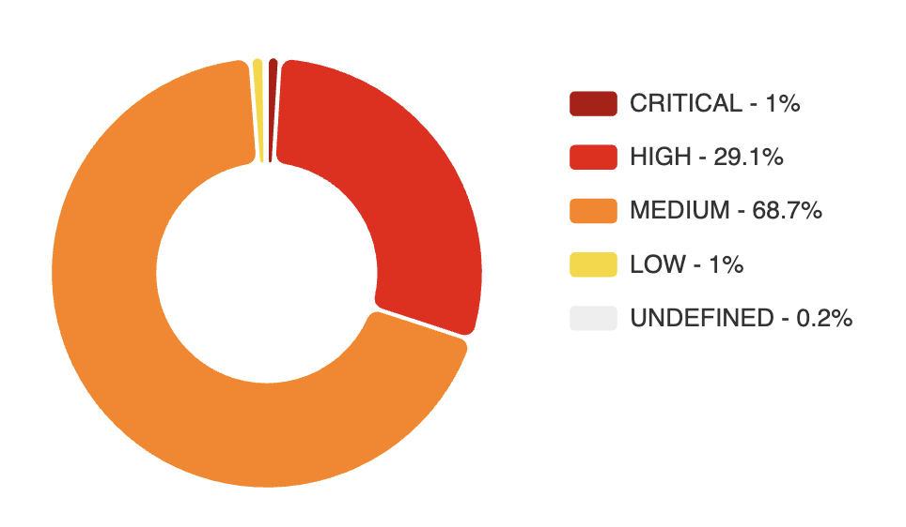
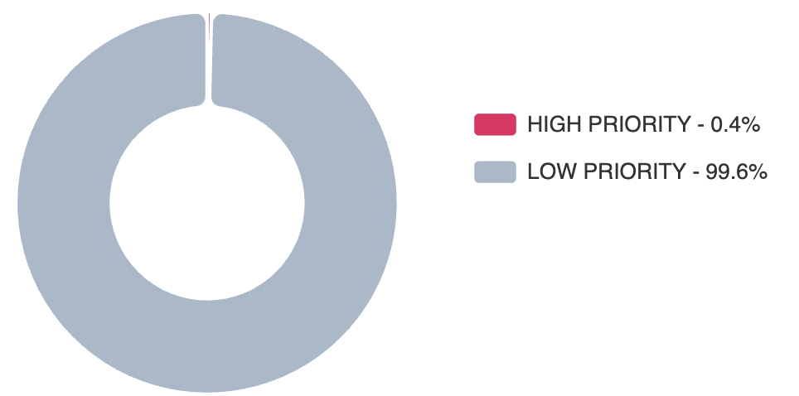
Impact in practice
2775 identified vulnerabilities
Prioritization based on Severity
CVSS Score > 7.0 (Critical & High)
834 vulnerabilities to triage ASAP (1% + 29.1%)
Prioritization based on Exploitability
Proof of Exploitation or Weaponized exploit
Attack Vector reachable by an attacker
10 vulnerabilities to triage ASAP (0.4%)
Notes:
This example shows the practical effect. Without context-based prioritization, teams face hundreds of issues. With ARIANNA's approach, the workload is narrowed down to a very small set of high-value actions.

Slide 14
ARIANNA KEV catalogue
ARIANNA KEV focuses on vulnerabilities with evidence of real exploitation.
It includes CISA KEV entries.
It also adds proof-of-exploitation signals from EUVD and verified or weaponized exploits detected by ARIANNA.
This gives broader and faster coverage than relying on CISA KEV alone.
Result: faster prioritization and faster remediation.
Notes:
One differentiator is ARIANNA KEV. We do not rely only on public KEV lists, but enrich them with additional exploitation evidence to accelerate prioritization and remediation.

Slide 15
Reports for customers & regulatory bodies
Export SBOM and HBOM in standard formats such as CycloneDX and SPDX.
Support NTIA minimum requirements.
Exclude selected components when needed.
Export vulnerability reports on demand in PDF or VEX format.
Generate automatic monthly PDF reports with a full audit trail of actions and status changes.
Notes:
ARIANNA also turns the process into something auditable and shareable. SBOMs, HBOMs, and vulnerability reports can be exported in standard formats for customers, internal teams, and regulators.

Slide 16


Collaboration among teams in ARIANNA
Different teams can manage their own projects in ARIANNA while sharing visibility where needed.
A system-level team can reuse vulnerability decisions already made by component teams.
That reduces duplicate triage effort and improves consistency across products and organizations.
VULNs
STATUS
PROJECT A
SBOM & HBOM
TEAM A
VULNs
STATUS
PROJECT B
SBOM & HBOM
TEAM B
Notes:
This is important in real organizations: multiple teams work on related products and components. ARIANNA allows them to reuse visibility and decisions, reducing duplicated effort and improving consistency.

Slide 17
What the demo will show
One connected device with 3 processing units:
PU1: i.MX93 MPU with Yocto + JavaScript + Python applications
PU2: STM32F4 MCU with bootloader + application firmware
PU3: ESP32 MCU with application firmware
Two model versions: initial model and an updated ESP32 firmware version
We will show:
The delta between model versions
New and automatically closed vulnerabilities
The high-priority vulnerability view
The exported final report
PU3|ESP32
PU1 | i.MX 93
PU2 | STM32F4
Notes:
In the demo, I will show one connected device with multiple processing units and two model versions. We will look at the delta between versions, the resulting vulnerability changes, and the final prioritized output.

Slide 18
Thank you
Notes:
The key message is that ARIANNA helps transform vulnerability management from a compliance burden into an operational process. The natural next step is to onboard one device and validate the workflow in practice.

